Slide 1
ROBOT Action Anticipation FOR COLLABORATIVE ASSEMBLY TASKS
Pedro Amaral nMec: 93283
Dissertation Proposal - MRSI

Slide 2






Outline
Problem Introduction
Collaborative Robotics
State of the Art Methods
Tools Review
Work
Progress
Work
Planning

Slide 3
Problem Introduction

Slide 4
INTRODUCTION
The concept of Human-Robot Collaboration (HRC) involves the research of mechanisms that allow humans and robots to work together to achieve a shared goal.
However, to achieve true collaboration, it is not enough to react to the partner’s movements and intentions, the robot must anticipate them.

Slide 5
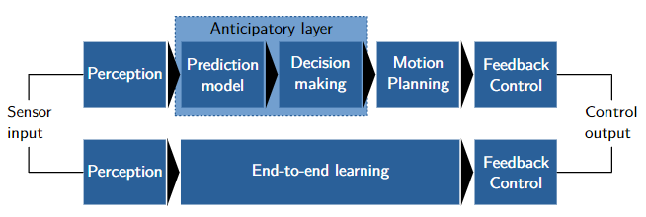
What is Anticipation?
Anticipation is viewed as the impact of predictions on the current behavior of a system, be it natural or artificial;
Anticipatory robots make decisions based on current states and predicted future states using predictive models of the environment.

Slide 6

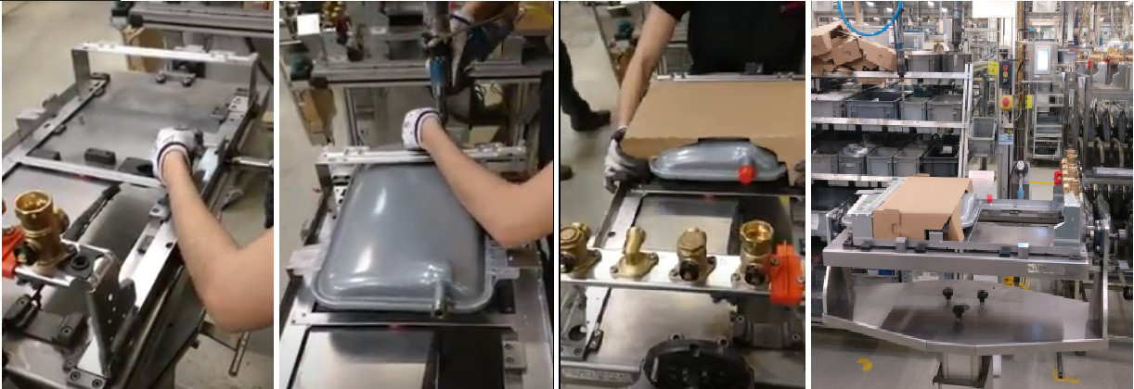
PROBLEM Definition
This dissertation aims at the development of an anticipatory system that allows to enhance human-robot collaboration in industrial settings under the AUGMANITY mobilizing project.
Use case: The collaborative robot’s main function will be to assist with the assembly task by placing the parts of gas boiler for water heating in the jig while coordinating its actions with those of the human operator.

Slide 7
Collaborative Robotics

Slide 8
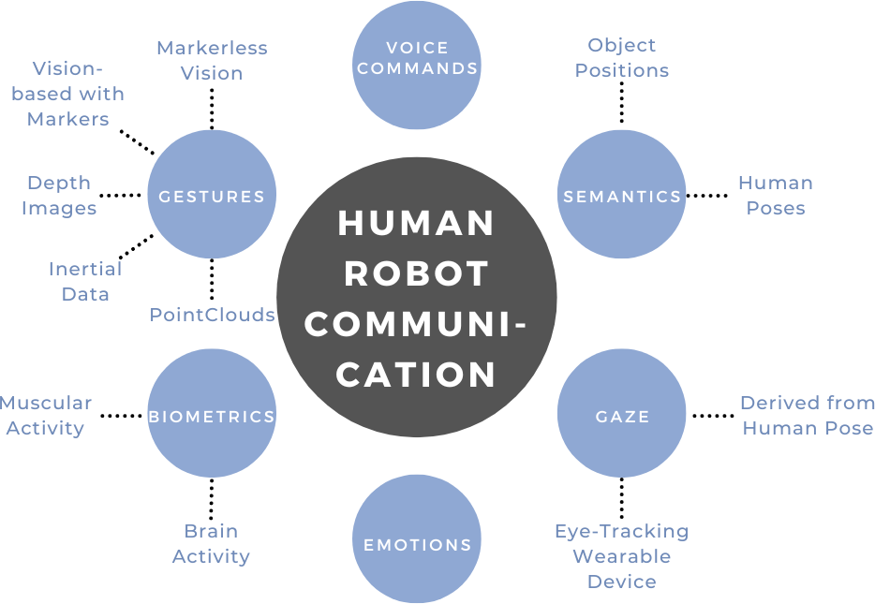
Human ROBOT Communication

Slide 9
SAFETY in Collaboration
Safety is a critical topic in Human-Robot Collaboration;
Traditional robots are in an isolated workspace so that they do not injure humans;
Collaborative robots need to be able to work with humans without injuring them;
ISO 10218-1 and 10218-2 are two norms created for this.

Slide 10
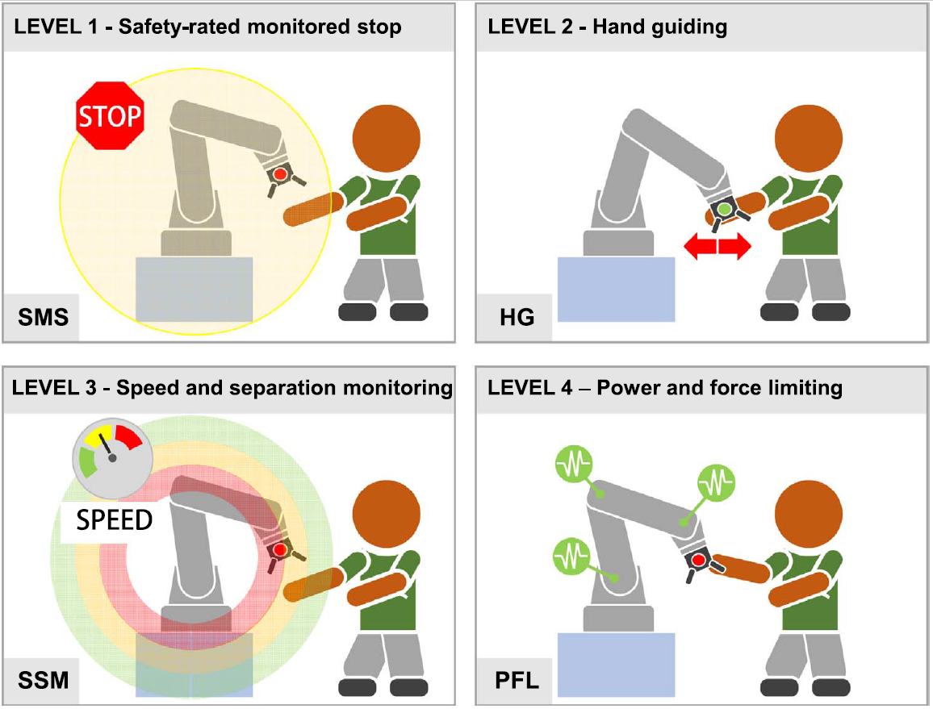
ISO 10218-1 and 10218-2 norms
Safety-rated monitored stop: when a human enters the cobot’s workspace, it completely stops;
Hand guiding: when an operator manually moves the cobot, it is compliant;
Speed and separation monitoring: as the human moves closer to the cobot, it becomes gradually slower;
Power and force limiting: the cobot has its operation restricted in terms of force and torque.

Slide 11
State of the Art Methods

Slide 12
Perception
Humans and robots can communicate through several methods;
In action anticipation, passive and indirect communication methods are used;
The user should not need to do anything for the robot to act, the robot must be able to understand the worker’s body language, such as his involuntary pose, gestures or gaze.

Slide 13
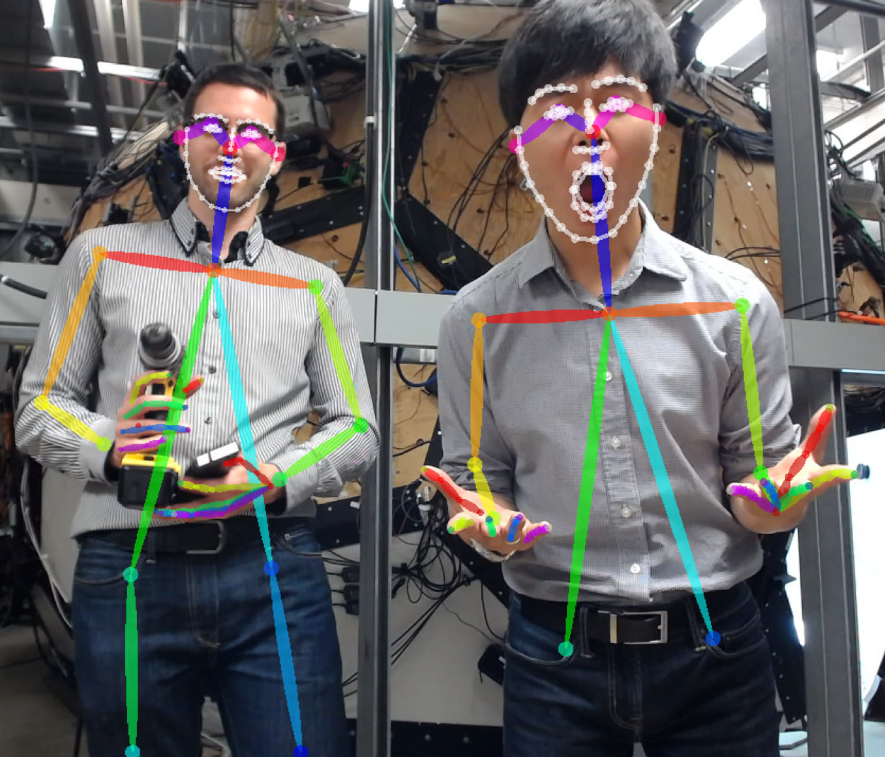
Sensors
Sensor | Nº Occurrences
RGB Camera | 9
RGB-D Camera | 1
Inertial Measurement Unit (IMU) | 1
Electromyography (EMG) Sensors | 1
Wearable Gaze Detector | 1
RGB Images can be used in different ways:
Directly in the model;
Process optical flow;
Process marker positions;
Input to key point detection frameworks.

Slide 14
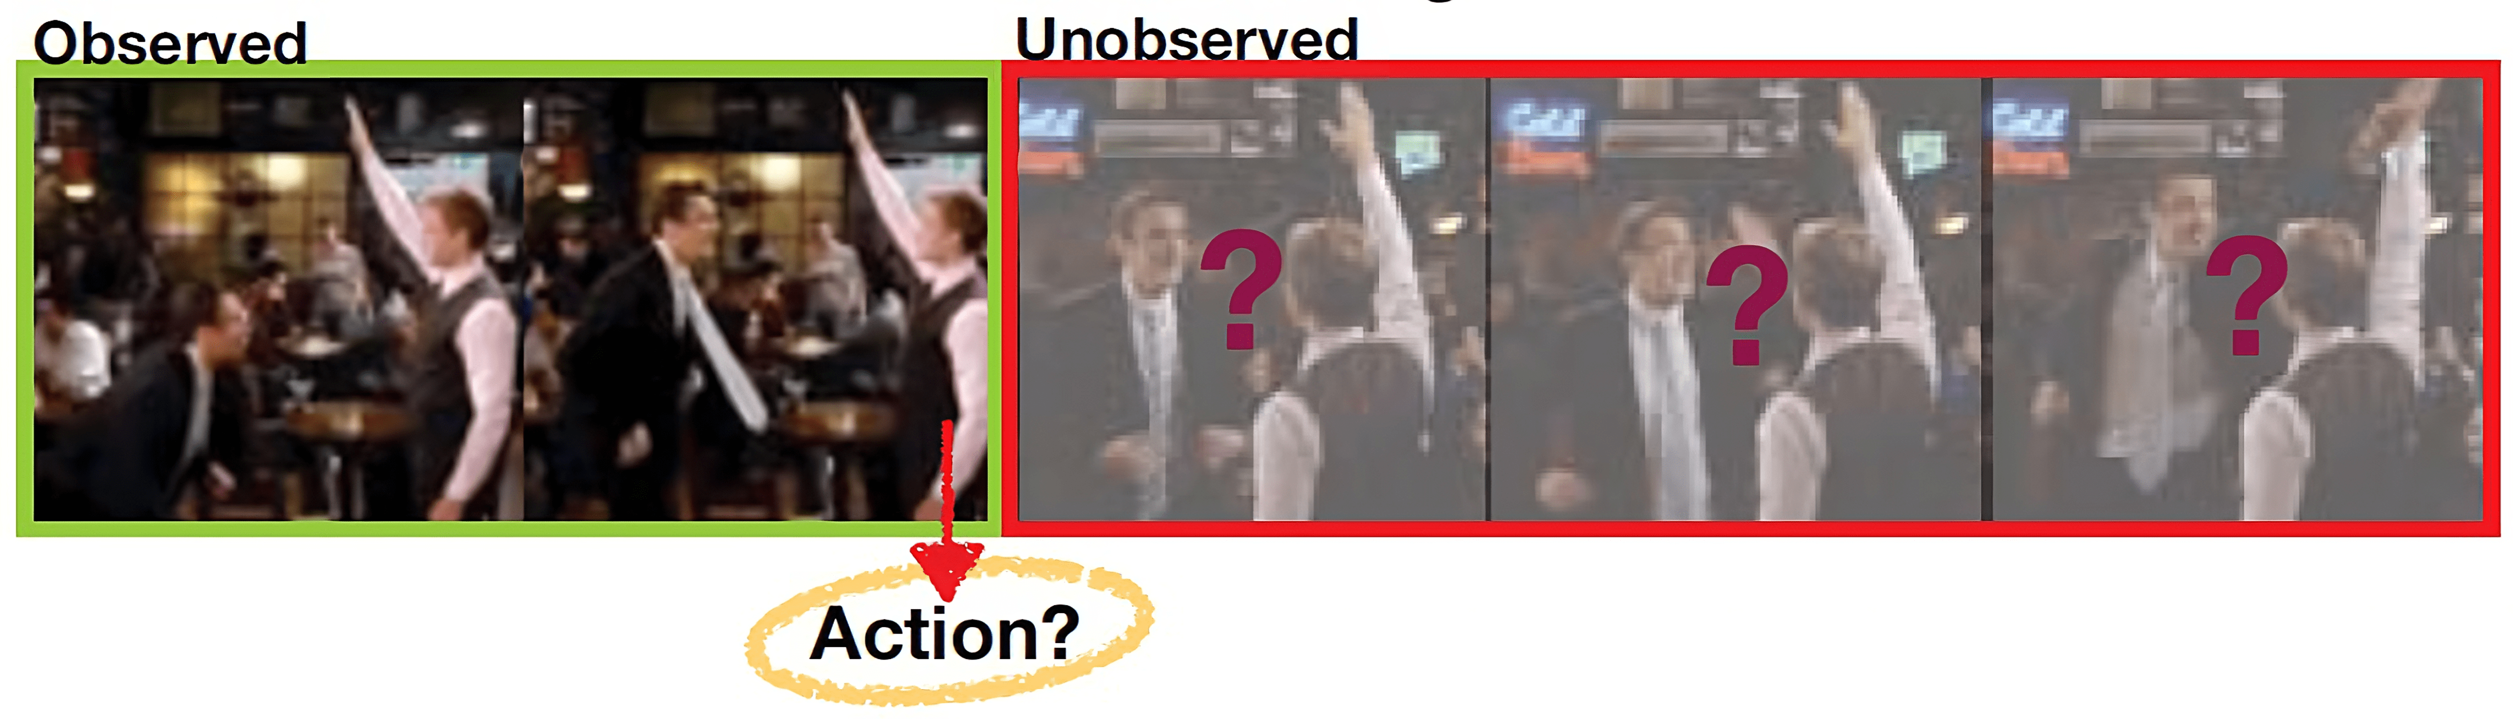
Predictive Models
Predicting the next action of the worker is a supervised learning problem;
It is possible to use a sequence of images that must be classified as a particular future action class.

Slide 15
Predictive Models
Model Name | Nº Occurrences
LSTM | 7
CNN | 3
TSN | 1
Nearest Neighbor | 1
SVM | 1
Model Name | Nº Occurrences
ResNet-34 | 1
ResNet-50 | 1
VGG-16 | 1
TS | 1
ConvNet | 1

Slide 16
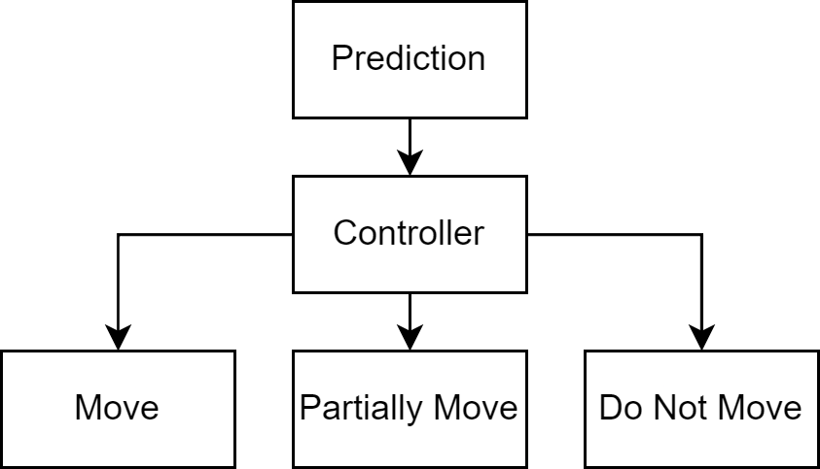
Decision-Making
Two options were found to decide when to move:
Wait until a certain level of certainty about the prediction to make the needed action;
As soon as it makes a prediction with a certain certainty threshold start slowly moving towards the target, do the entire action after it reaches a second threshold.

Slide 17
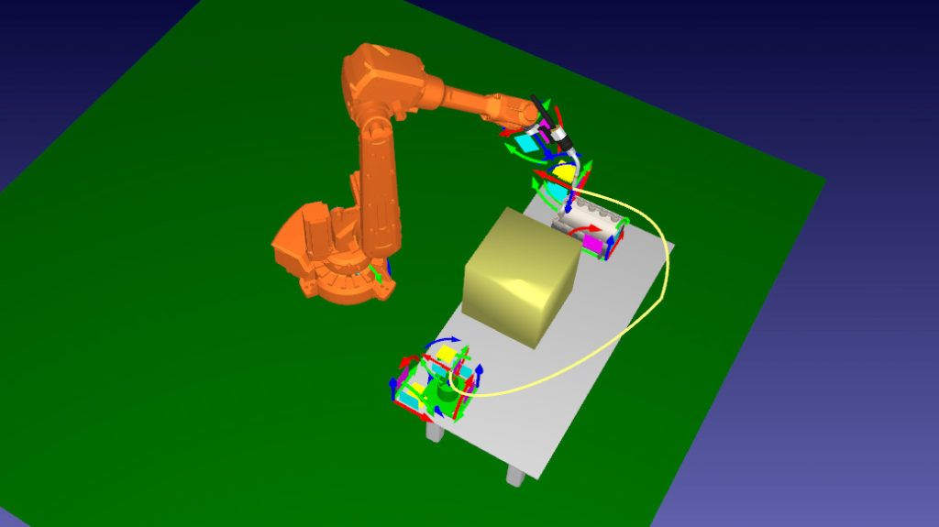
Motion Planning
Two options were found to decide when to move:
Use ROS Open Motion Planning Library (OMPL) and MoveIt! to handle the trajectory planning jobs;
Plan trajectories considering previous poses when doing this interaction to avoid collisions.

Slide 18
Tools Review

Slide 19

Experimental Setup
The experimental part of this thesis will be developed using the setup available at the Laboratory for Automation and Robotics (LAR);
The available setup contains a collaborative robot surrounded by several sensors and a powerful computer that can be used to train machine learning models;
All communication is established using ROS making it a compulsory tool.

Slide 20


Machine Learning
Frameworks
Two options were reviewed for the development of the machine learning models and data pre-processing:
Tensorflow
Pytorch

Slide 21
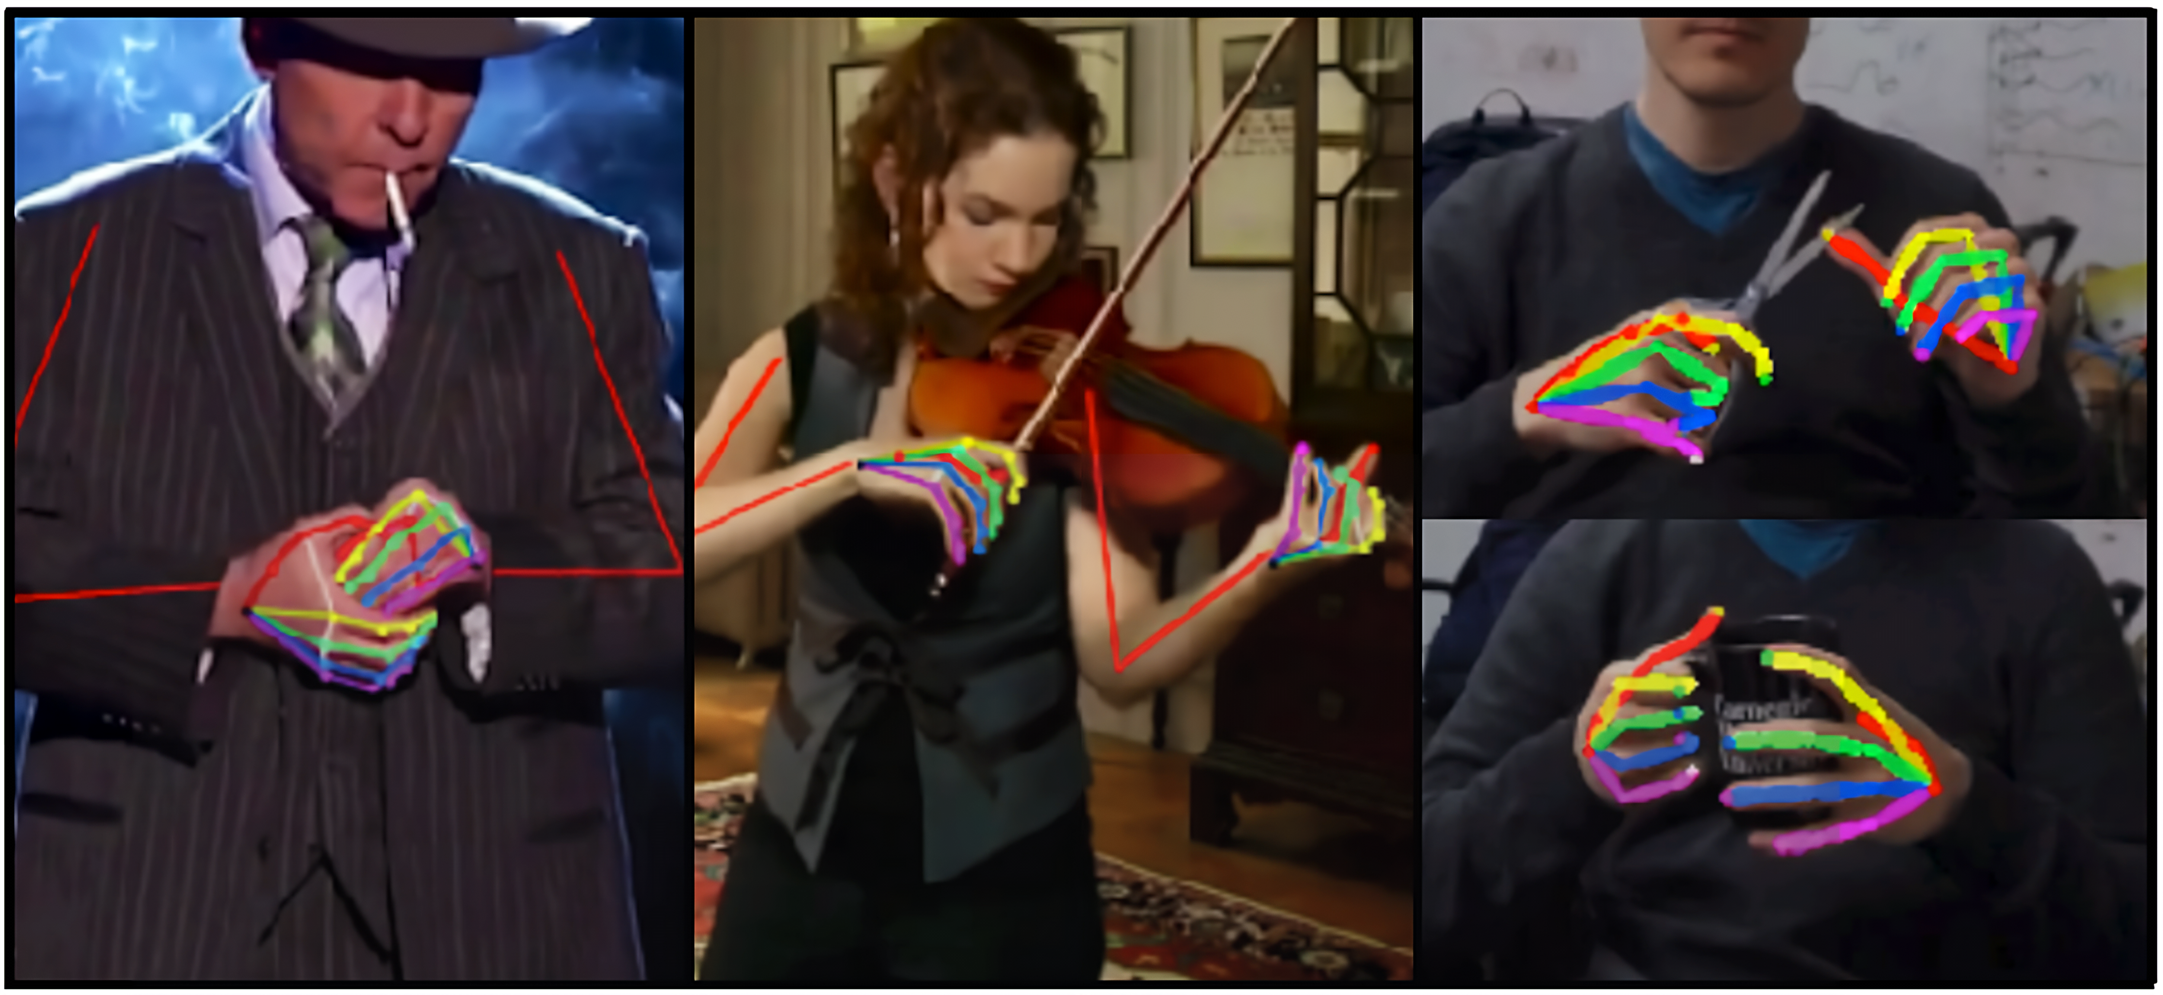
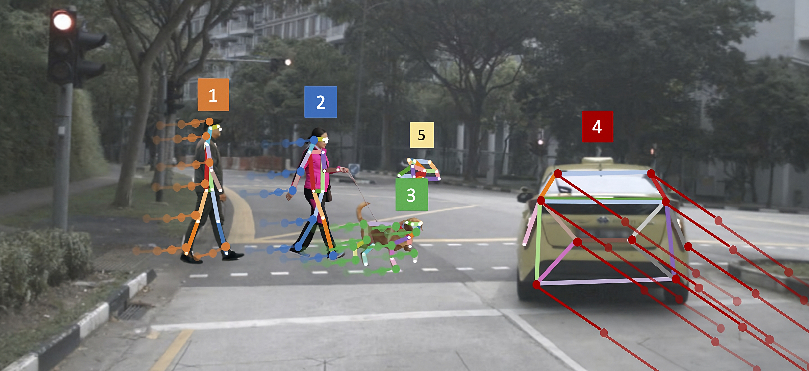
KEY POINT DETECTION FRameworks
OpenPose
OpenPifPaf

Slide 22
Work Progress

Slide 23
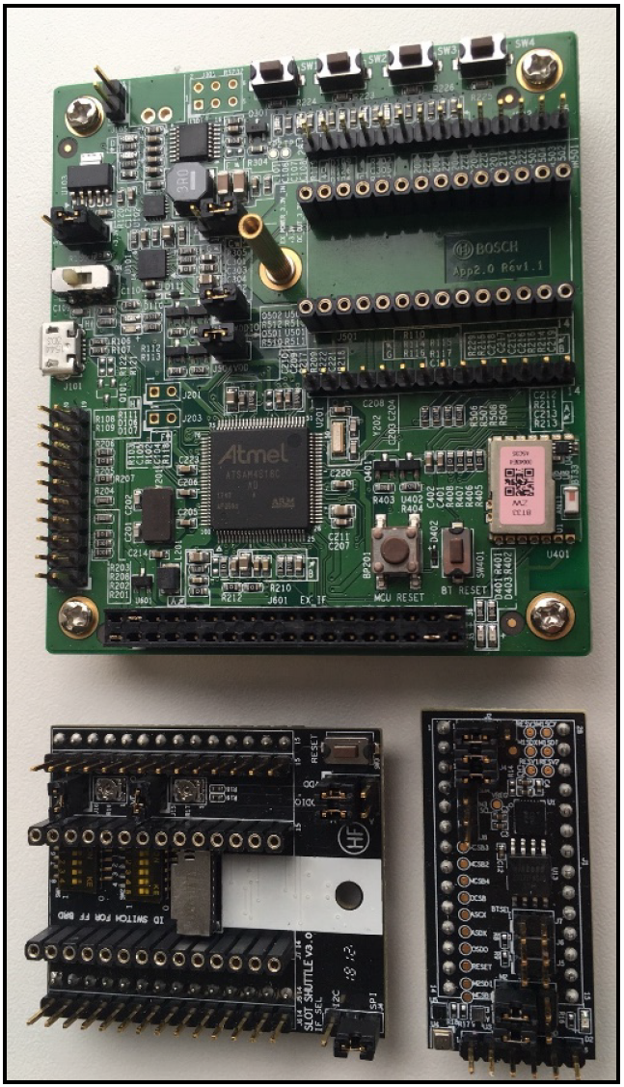
Sensor BHI260AP
BHI260AP is a smart sensor with integrated Inertial Measurement Unit (IMU) from Bosch Sensortec.
It could be used to help detect gestures with the end goal of helping and automating the labeling of the model training data.

Slide 24
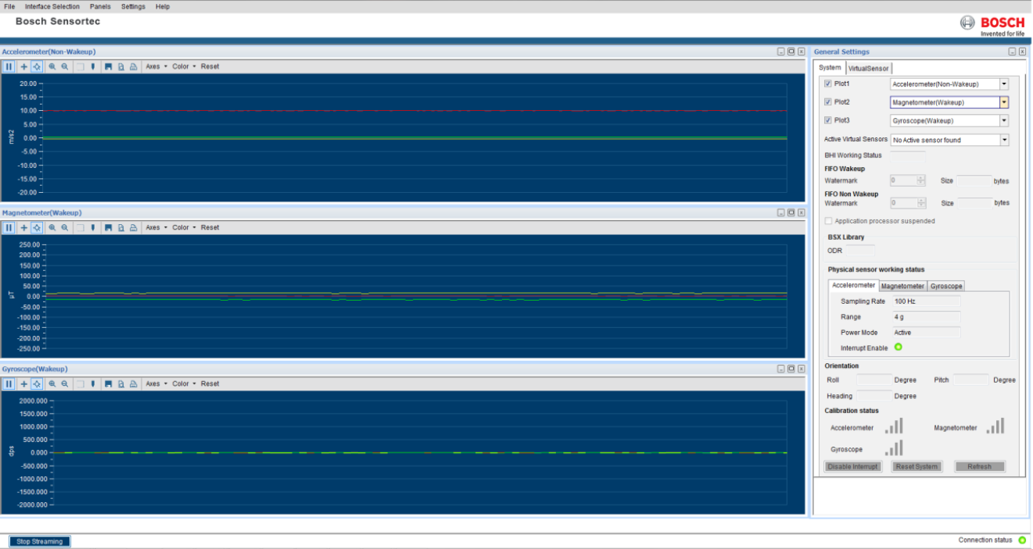
Communication Approaches
Three options were tested for establishing communication with the sensor:
C++ API – does not compile;
Python API – connects but there is no documentation;
Development Desktop 2.0 – collects data but only works in windows.

Slide 25
Work Planning

Slide 26
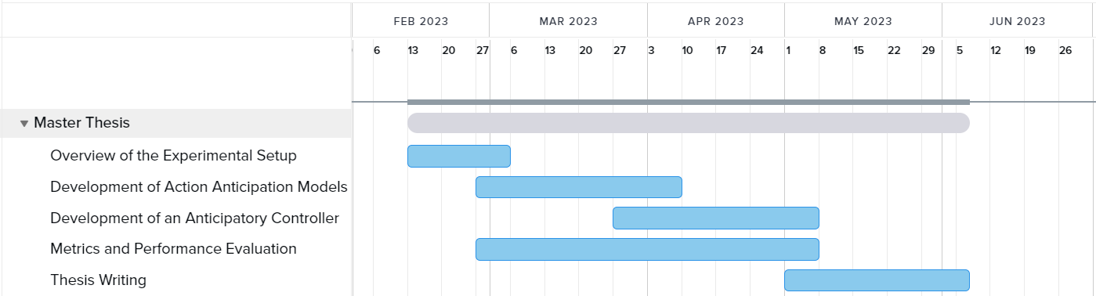
Future Work Planning

Slide 27
Conclusion

Slide 28
Conclusion
There was a clear predominance of RGB cameras for perception;
LSTMs and CNNs were the most common predictive models;
Some relevant tools were reviewed;
An inertial sensor was tested although further work is necessary for it to be useful;
The tasks for the second semester are scheduled.

Slide 29
THANK YOU

